Slide 1
Introduction to RNAseq
최 창 순

Slide 3
Biological Background

Slide 4
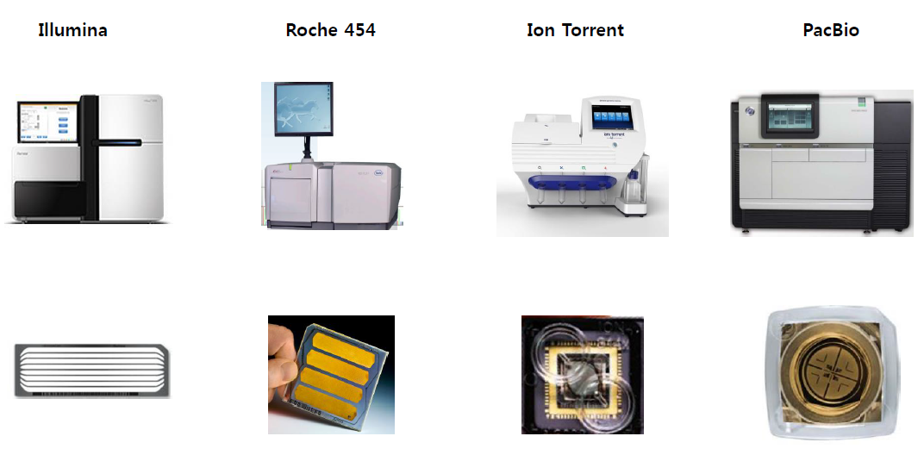
RNA-Seq workflow

Slide 5
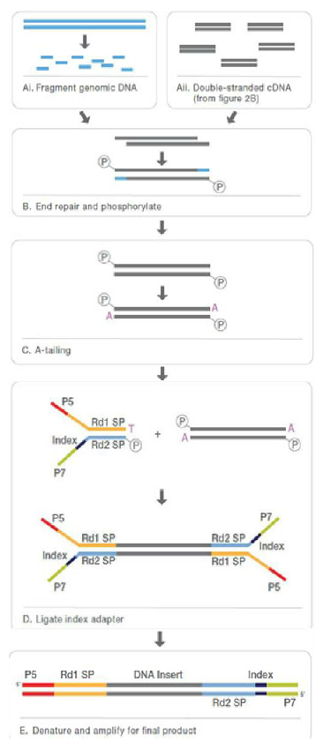
Illumina: Workflow overview
Extract DNA
: Sample로부터 DNA 추출
2. Fragment DNA
: 추출한 DNA 를600 bases 이하의 크기로 조각 냄
3. Ligate adapters
: 하나의DNA fragment양끝에DNA fragment와flow cell의 표면에 있는oligo를 연결해주는adapter (부분적으로 상보적인 염기서열을 지니는 두 개의 oligo)를 붙여줌
: Adapter의 구성
-PCR primer가 붙을 수 있는 염기서열
-Sequencing primer가 붙을 수 있는 염기서열
-6-base의index

Slide 6
Illumina: Workflow overview
4. Surface with complementary oligo
: “3”번 단계에서 사용한 adapter에 상보적인 oligo가 수 백만개 붙어있는 plate 준비.
5 Hybridize library
: Flow cell 표면의 oligo에 adaptor가 붙은 DNA 조각들이 결합.
6 Amplify hybridized template
: Flow cell에 결합한 각각의 DNA 조각들을 증폭하여 수 천개의 동일한 DNA 조각들로 이루어진 cluster들을 만듦.
7 Anneal universal sequencing primer
: Adapter sequence 내에 존재하는 염기서열에universal sequencing prime를 붙임.
8 Sequence with fluorescent nucleotides
: 형광표지가 달린 nucleotides를 이용하여 template의sequence를 읽어냄.
9. Base call
: Base calling은template sequence 중에 자동적으로 이루어짐.

Slide 7
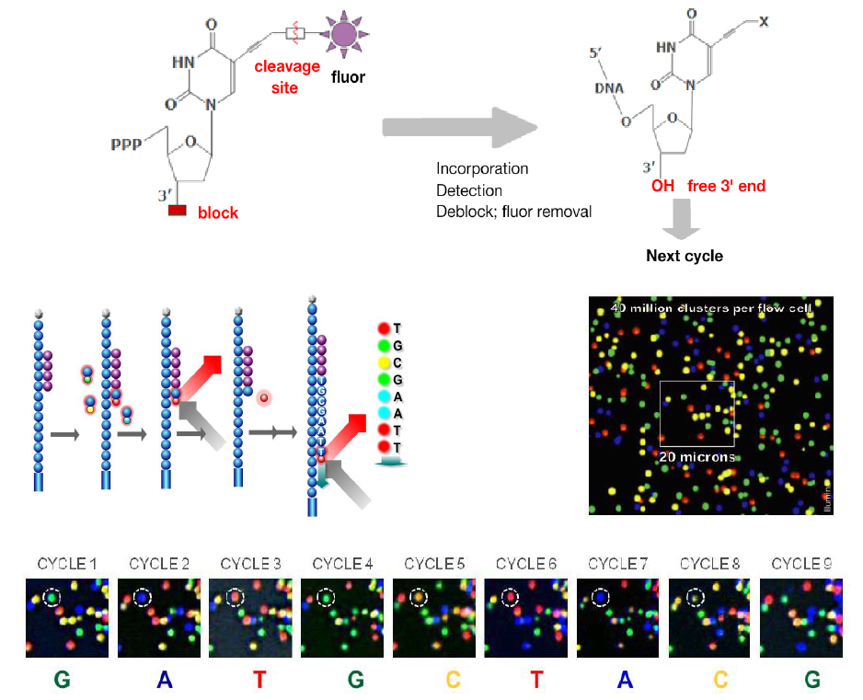
Sequencing by Systhesis(SBS)

Slide 8
Depth of coverage
• NGS는 Genome이나 RNA 위의 한 염기를 1번 이상 sequencing하는 것이 일반적이며, 한 염기위치를 평균 몇 번을 sequencing 했는지를 “Depth of coverage”라고 하며, 줄여서“sequencing depth" 혹은"coverage” 라고도 함.
• NGS 실험 시에 sequencing의 양, 즉 얻고자하는 coverage는 실험 전에 유전체의 크기 및 사용목적과 연계하여 고려해야함.
-일반적으로 유전자 변이 확인이나 de novo sequencing 시에는 높은coverage가 요구됨.
• RNA-Seq에서는 얼마나 많은read를 얻어야 충분한가? (Haas et al., 2012, Nagalakshmiet al., 2008)
-E. coli: 5~10 million reads (non-rRNA reads)
-Eukaryotes: >30 million reads for moderately expressed genes

Slide 9
Read length
• NGS sequencing 시DNA 조각의 한쪽 끝에서만 염기서열을 읽을 것인지 양쪽 끝 모두에서 염기서열을 읽어낼 것인지를 정해야 함
-"Single-end“ sequencing
: 한쪽 끝에서만 염기서열 분석
-"Paired-end" sequencing
: 양쪽 끝 모두에서 염기서열 분석
• Library 준비 전에 각 실험에 맞는 read length 결정필요
• 항상 long read 혹은paired-end sequencing을 할 필요는 없음
- MicroRNA는 보통 30 bases 이하
- ChIP-Seq으로DNA-protein binding sites를 찾고자 할 때 read length가35 ~ 50 bases 정도면 결합위치 확인 가능
- DNA가 심하게 degradation된 경우long read 불가
• De novo sequencing과 같은 경우에는 long, paired-end reads 반드시 필요

Slide 10
Types of RNA

Slide 11
Types of RNA

Slide 12
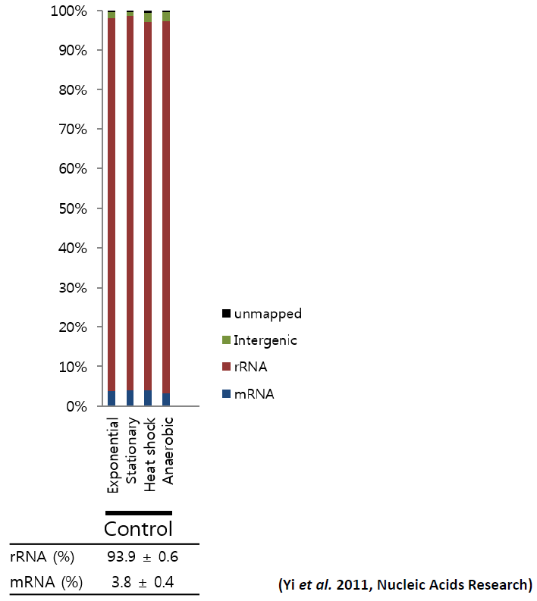
rRNA depletion

Slide 13
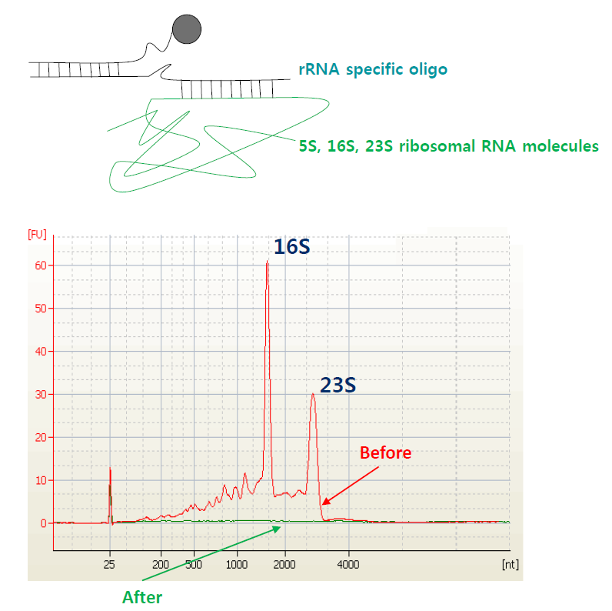
rRNA depletion

Slide 14
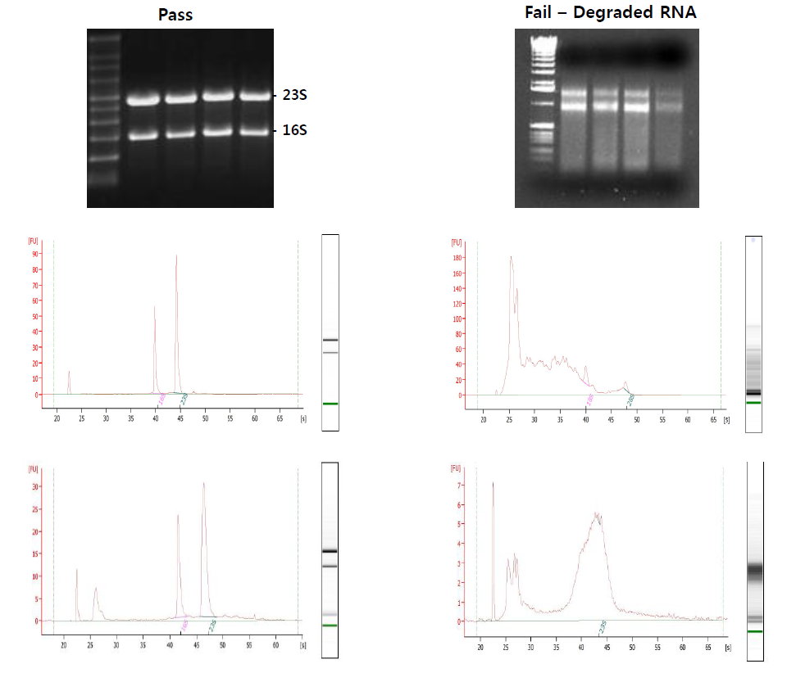
Quality Check

Slide 15
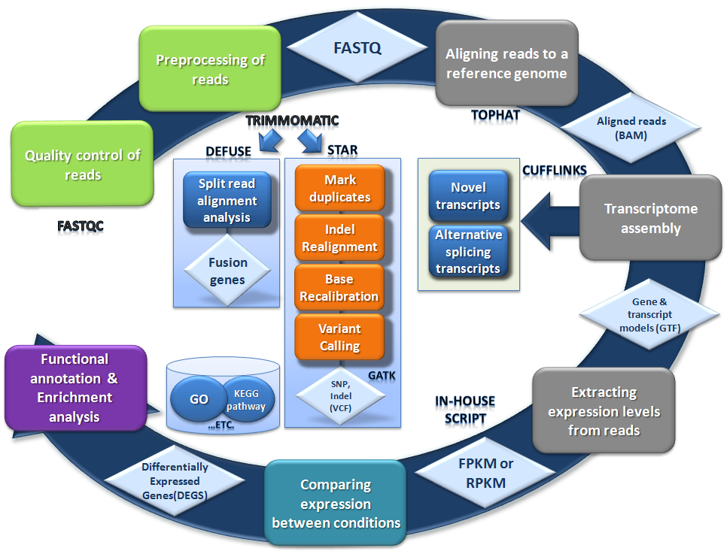
RNA Seq Analysis Pipeline (Reseq)

Slide 16
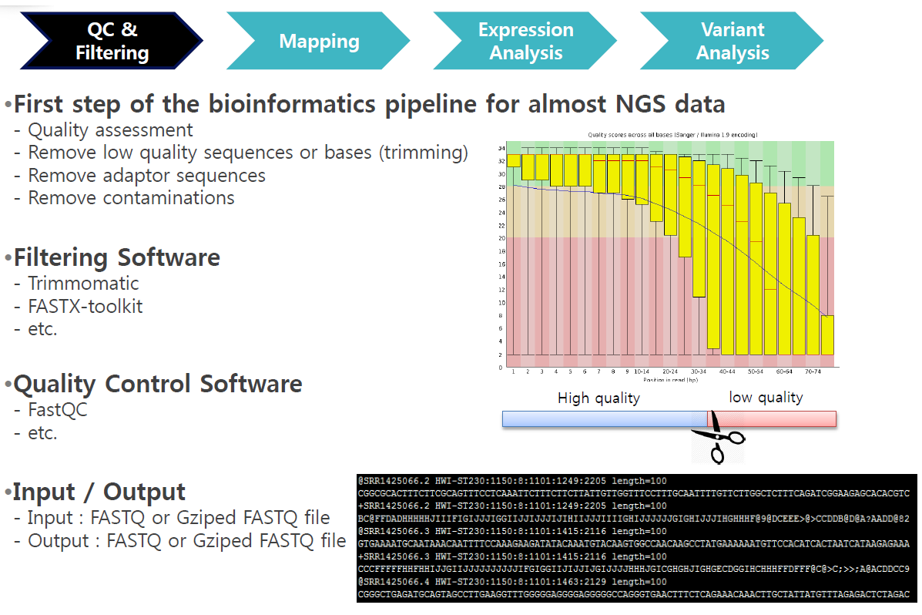

Slide 17
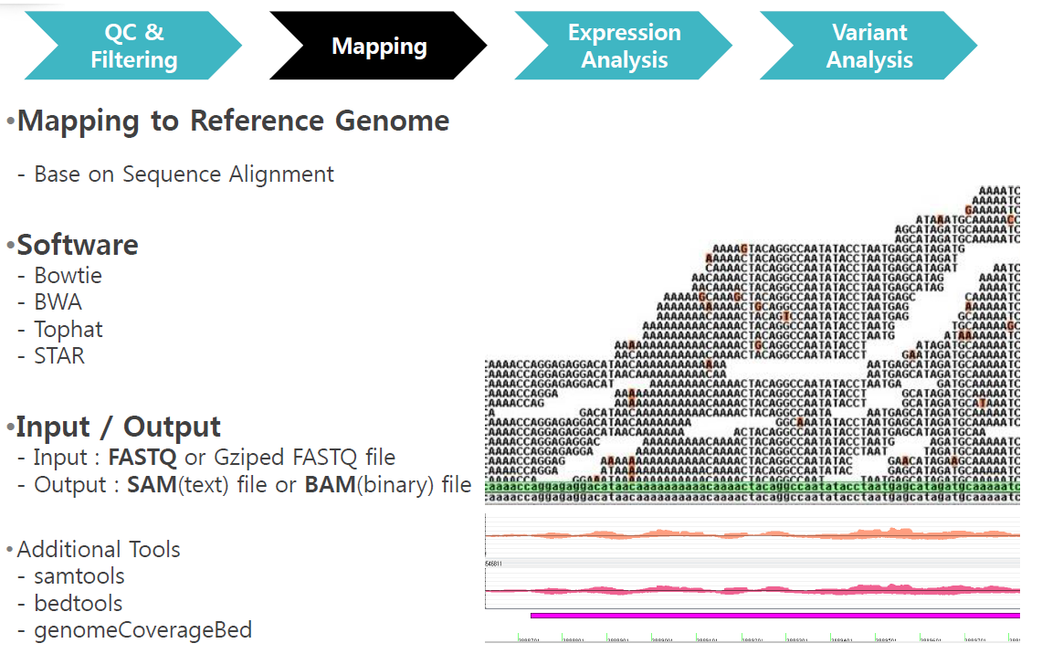

Slide 19
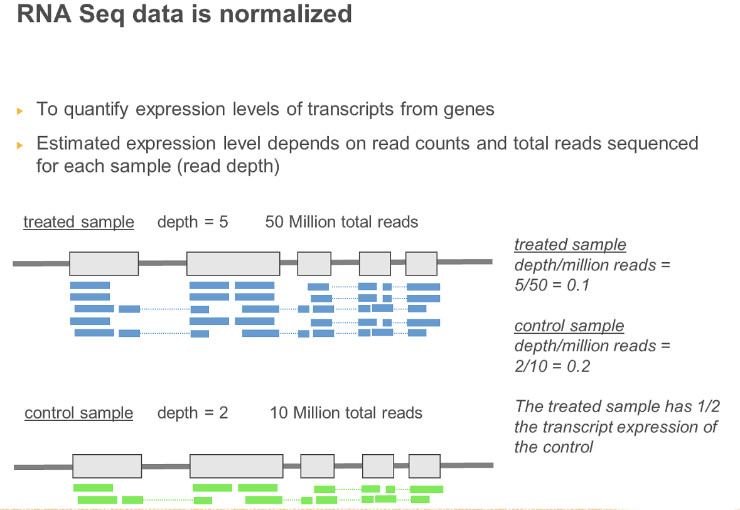
RNA Seq transcript normalization
To quantify expression levels of transcripts from genes
Estimated expression level depends on read counts and total reads sequenced for each sample (read depth)

Slide 20
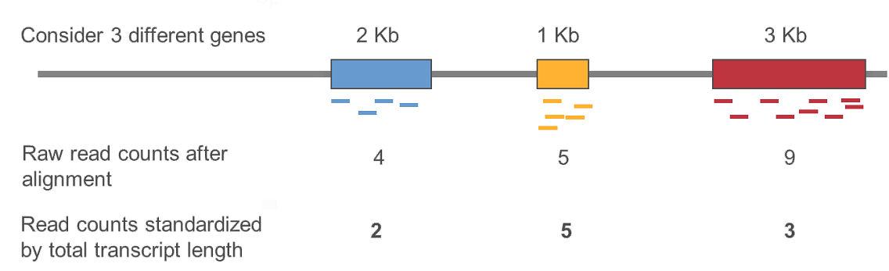
RNA Seq transcript normalization
Read counts also depend on total gene length (length of all exons)

Slide 21
RPKM, FPKM
RPKM (Reads Per Kilobase of exon per Millon of mapped reads) - Single read normalization
FPKM (Fragments Per Kilobase of exon per Million of mapped reads) - Paired end normalization
RNA Seq fragment counts can be used as a measure of relative abundance of transcripts
For Normalized genes and exons : RPKM = (10⁹ x Cb) / (Nb x L) - Cb = the number of bases that fall on the feature - Nb= the total number of mapped bases in the experiment - L = Length of the feature in base pairs
Ai Martazavi et al. Mapping and quantifying mammalian transcriptomes by RNA-Seq Nature Methods, Vol 5, 621-628(2008)

Slide 22
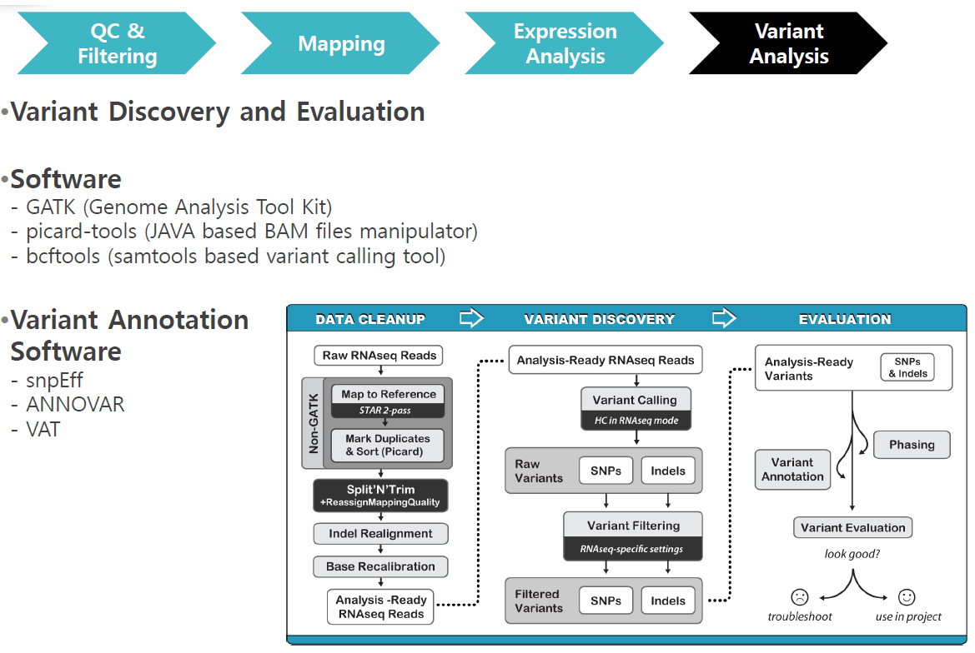

Slide 23
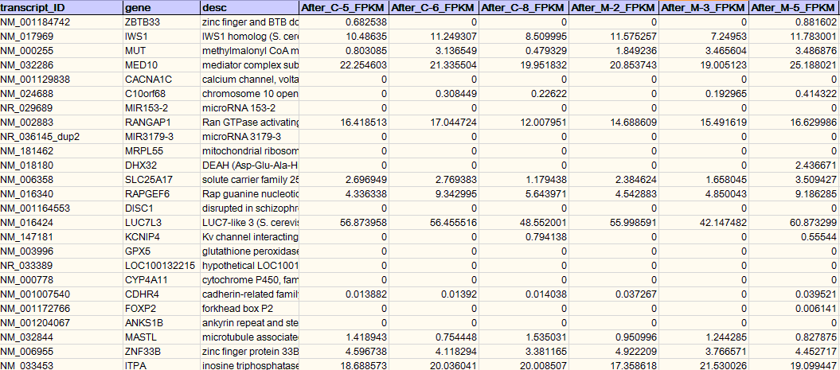
Expression Profile of RNA Seq
Samples
transcript
Expression( mRNA Seq, miRNA Seq) - 연속형 각 transcript 별, 샘플별 FPKM or RPKM

Slide 24
DEG Scheme of RNA Seq
Normal group
Patients group
Gene A
Gene A

Slide 25
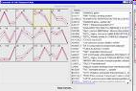
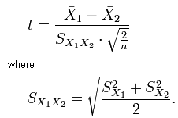
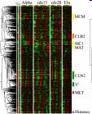
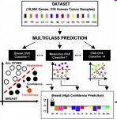
j
Gene A
Gene A
FPKM
FPKM
 | Sample1 | Sample2 | Sample3
Gene A | 9 | 14 | 15
Gene B
 |  | . . .
Gene N
 | Sample1 | Sample2 | Sample3
Gene A | 4 | 5 | 3
Gene B
 |  | . . .
Gene N
Statistical test
Higher level
Analysis
Data mining
Interpretation

Slide 26
Analysis workflow of Expression data
Step | Content | Tool
1 . Extraction of Raw data | Expression profile (Read count, FPKM, RPKM) from RNA-Seq Expression profile(Signal Intensity) from chip | TopHat (bowtie) - cufflinks pipeline Illumina GenomeStudio Expression Module Affymetrix Expression Console - RMA
2. Quality Control | nonzero FPKM, RPKM Detection pval, FLAG(P,M,A) fail count various QC plots | R
3. Data preprocessing | log transformation normalization | R (TMM, quantile, upper quantile etc.)
4. Statistical comparisons | Statistical test for comparisons | R (t-test, paired t-test, ANOVA, linear regression, Wilcoxon rank sum test etc.)
5. Data visualization | For significant genes, volume plot, volcano plot, clustering analysis | R (Hierarchical clustering, k-means etc.)
6. Functional annotation | Gene Ontology, KEGG pathway annotation, Functional clustering using DAVID | DAVID KEGG, GO
7. Gene set enrichment Analysis (optional) | For Gene sets based on MsigDB of Broad Institute, enrichment analysis | GSEA

Slide 27
Statistical Methods according to data type
 | 정규분포를 따르는 모집단에서 얻은 측정치 | 비정규분포 집단에서 얻은 측정치 또는 순위, 점수 | 이분변수 | 생존시간
한 개 군의 기술 | Mean, SD | Median, IQR | Proportion | Kaplan-Meier survival curve
한 개 군을 이론상의 값과 비교 | One-sample t-test | Wilcoxon test | Chi-square test or binomial test
두 개의 짝 지워 지지 않은 군을 비교 | Unpaired t-test | Mann-Whitney test | Fisher’s Exact test (chi-square for large samples) | Log-rank test or Mantel-Haenszel
두 개의 짝지어진 군을 비교 | Paired t-test | Wilcoxon signed rank sum test | McNemar’s test | Conditional proportional hazard regression
세 개 이상의 짝 지워 지지 않은 군의 비교 | One-way ANOVA | Kruskal-Wallis test | Chi-square test | Cox proportional hazard regression
세 개 이상의 짝지어진 군의 비교 | Repeated –measured ANOVA | Friedman test | Cochrane Q | Conditional proportional hazards regression
두 변수의 연관성 | Pearson correlation | Spearman correlation | Contingency coefficients
하나의 측정치로부터 다른 값의 예측 | Simple linear regression or Nonlinear regression | Nonparametric regression | Simple logistic regression | Cox proportional hazard regression
여러 측정치 또는 이분변수로부터 다른 값의 예측 | Multiple linear regression or Multiple nonlinear regression |  | Multiple logistic regression | Cox proportional hazard regression

Slide 28
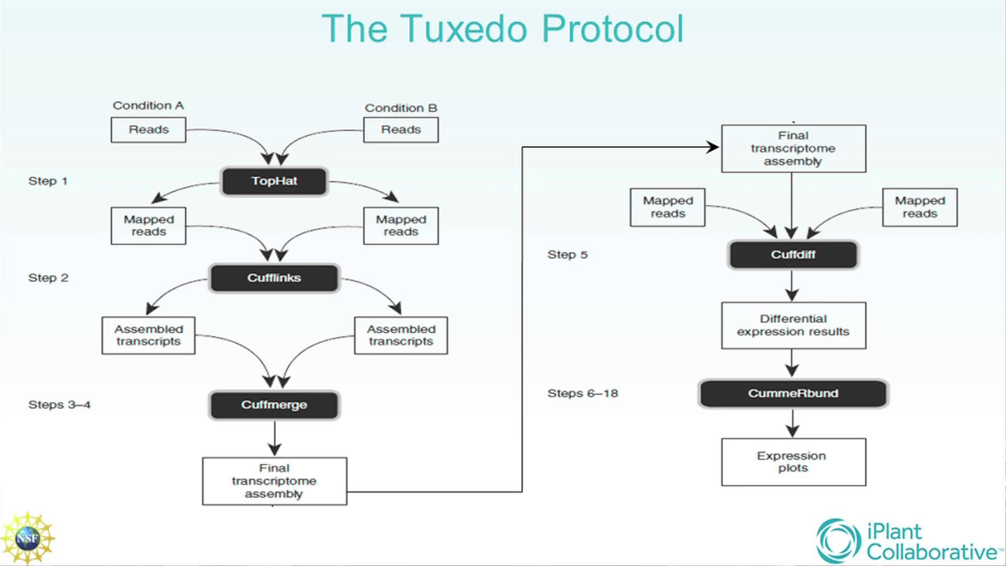

Slide 29
## check sequence quality using FastQC
mkdir FastQC
fastqc -t 4 -f fastq A_1.fastq -outdir=FastQC --nogroup
fastqc -t 4 -f fastq A_2.fastq -outdir=FastQC --nogroup
fastqc -t 4 -f fastq B_1.fastq -outdir=FastQC --nogroup
fastqc -t 4 -f fastq B_2.fastq -outdir=FastQC --nogroup
fastqc -t 4 -f fastq C_1.fastq -outdir=FastQC --nogroup
fastqc -t 4 -f fastq C_2.fastq -outdir=FastQC --nogroup
fastqc -t 4 -f fastq D_1.fastq -outdir=FastQC --nogroup
fastqc -t 4 -f fastq D_2.fastq -outdir=FastQC --nogroup

Slide 30
## trimming adapter a low quality using Trimmomatic
mkdir Trim Unpair
java -jar /usr/tools/Trimmomatic-0.33/trimmomatic-0.33.jar PE -phred33 A_1.fastq A_2.fastq ./Trim/A_1_trim.fastq ./Unpair/A_1_unpair.fastq ./Trim/A_2_trim.fastq ./Unpair/A_2_unpair.fastq ILLUMINACLIP:/usr/tools/Trimmomatic-0.33/adapters/TruSeq3-PE.fa:2:30:10 LEADING:3 TRAILING:3 SLIDINGWINDOW:4:15 MINLEN:36
java -jar /usr/tools/Trimmomatic-0.33/trimmomatic-0.33.jar PE -phred33 B_1.fastq B_2.fastq ./Trim/B_1_trim.fastq ./Unpair/B_1_unpair.fastq ./Trim/B_2_trim.fastq ./Unpair/B_2_unpair.fastq ILLUMINACLIP:/usr/tools/Trimmomatic-0.33/adapters/TruSeq3-PE.fa:2:30:10 LEADING:3 TRAILING:3 SLIDINGWINDOW:4:15 MINLEN:36
java -jar /usr/tools/Trimmomatic-0.33/trimmomatic-0.33.jar PE -phred33 C_1.fastq C_2.fastq ./Trim/C_1_trim.fastq ./Unpair/C_1_unpair.fastq ./Trim/C_2_trim.fastq ./Unpair/C_2_unpair.fastq ILLUMINACLIP:/usr/tools/Trimmomatic-0.33/adapters/TruSeq3-PE.fa:2:30:10 LEADING:3 TRAILING:3 SLIDINGWINDOW:4:15 MINLEN:36
java -jar /usr/tools/Trimmomatic-0.33/trimmomatic-0.33.jar PE -phred33 D_1.fastq D_2.fastq ./Trim/D_1_trim.fastq ./Unpair/D_1_unpair.fastq ./Trim/D_2_trim.fastq ./Unpair/D_2_unpair.fastq ILLUMINACLIP:/usr/tools/Trimmomatic-0.33/adapters/TruSeq3-PE.fa:2:30:10 LEADING:3 TRAILING:3 SLIDINGWINDOW:4:15 MINLEN:36

Slide 31
## bowtie1-index파일 만들기
bowtie1-build <reference_in> <bt2_basename>
bowtie1-build chr19.fa chr19
### mapping using tophat (~3h)
tophat2 -G ../../annotation/chr19_hg19.gtf -p 4 --library-type=fr-firststrand -o TopHat_result_A -r 100 ../../reference/chr19 A_1_trim.fastq A_2_trim.fastq
tophat2 -G ../../annotation/chr19_hg19.gtf -p 4 --library-type=fr-firststrand -o TopHat_result_B -r 100 ../../reference/chr19 B_1_trim.fastq B_2_trim.fastq
tophat2 -G ../../annotation/chr19_hg19.gtf -p 4 --library-type=fr-firststrand -o TopHat_result_C -r 100 ../../reference/chr19 C_1_trim.fastq C_2_trim.fastq
tophat2 -G ../../annotation/chr19_hg19.gtf -p 4 --library-type=fr-firststrand -o TopHat_result_D -r 100 ../../reference/chr19 D_1_trim.fastq D_2_trim.fastq

Slide 32
## transcript assembly using cufflinks (~10m)
cufflinks -o Cufflinks_result_A -G ../../annotation/chr19_hg19.gtf -b ../../reference/chr19.fa -u --library-type fr-firststrand ./TopHat_result_A/accepted_hits.bam
cufflinks -o Cufflinks_result_B -G ../../annotation/chr19_hg19.gtf -b ../../reference/chr19.fa -u --library-type fr-firststrand ./TopHat_result_B/accepted_hits.bam
cufflinks -o Cufflinks_result_C -G ../../annotation/chr19_hg19.gtf -b ../../reference/chr19.fa -u --library-type fr-firststrand ./TopHat_result_C/accepted_hits.bam
cufflinks -o Cufflinks_result_D -G ../../annotation/chr19_hg19.gtf -b ../../reference/chr19.fa -u --library-type fr-firststrand ./TopHat_result_D/accepted_hits.bam
## make a assemblies file
ls ./Cufflinks*/transcripts.gtf > assemblies.txt
## make a merged gtf file using cuffmerge
cuffmerge -g ../../annotation/chr19_hg19.gtf -s ../../reference/chr19.fa -p 4 assemblies.txt
## identifying differentially expressed genes and transcripts using cuffdiff
cuffdiff -o cuffdiff_result -b ../../reference/chr19.fa --library-type fr-firststrand merged_asm/merged.gtf -u -L normal,tumor ./TopHat_result_A/accepted_hits.bam,./TopHat_result_C/accepted_hits.bam ./TopHat_result_B/accepted_hits.bam,./TopHat_result_D/accepted_hits.bam
## get read counts from bam files
bedtools multicov -bams run.bam -bed genes.bed
bedtools multicov -bams run1.bam run2.bam run3.bam -bed genes.bed

